Slide 1
Ultra Simple Networked Digital Signage.
Digital Bulletin Boards
For businesses, college campuses, and local government.
Contact:
Wes Warren
wes@digifli.com
https://digifli.com
Reduce Costs
Reduce Waste
Lead with Innovation
Increase Engagement

Slide 2
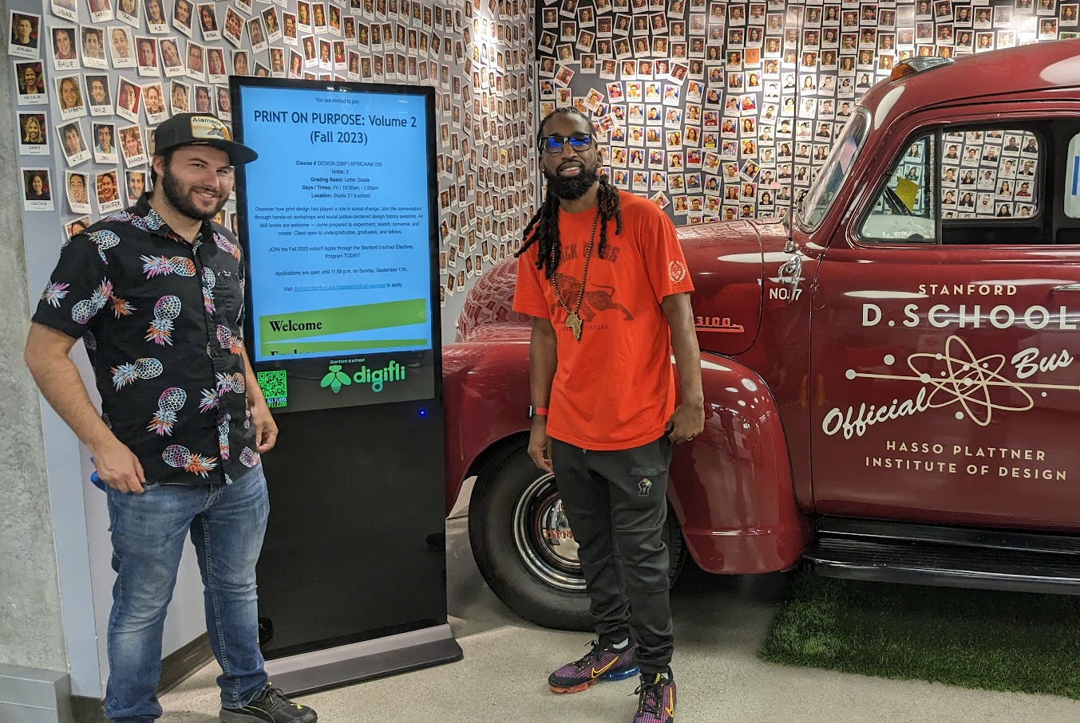
Digifli Digital Bulletin Boards
Background: Digifli started in Alameda, CA in 2017 as a Community Bulletin Board for local businesses and nonprofits.
In 2023 Stanford University approached Digifli about customizing the system for the d.school campus.
We worked with Stanford and created a private network to reduce costs, streamline communication, and enhance engagement.
“Our partnership with Digifli has not just met but exceeded our expectations, helping us build a more connected and responsive campus environment.”
Milan Drake
Community Design Lead - Stanford

Slide 3
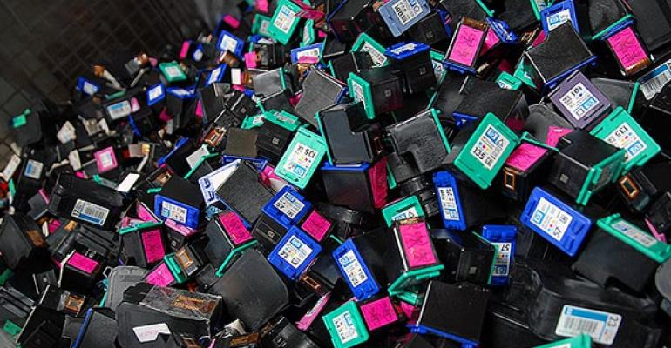
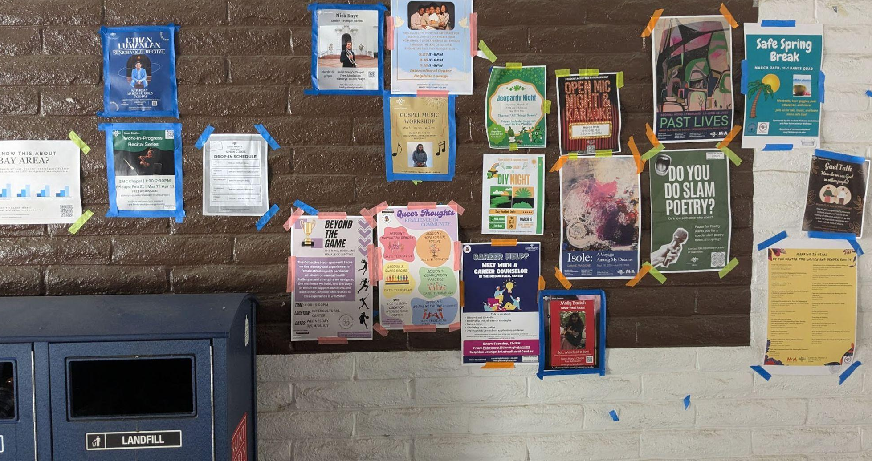
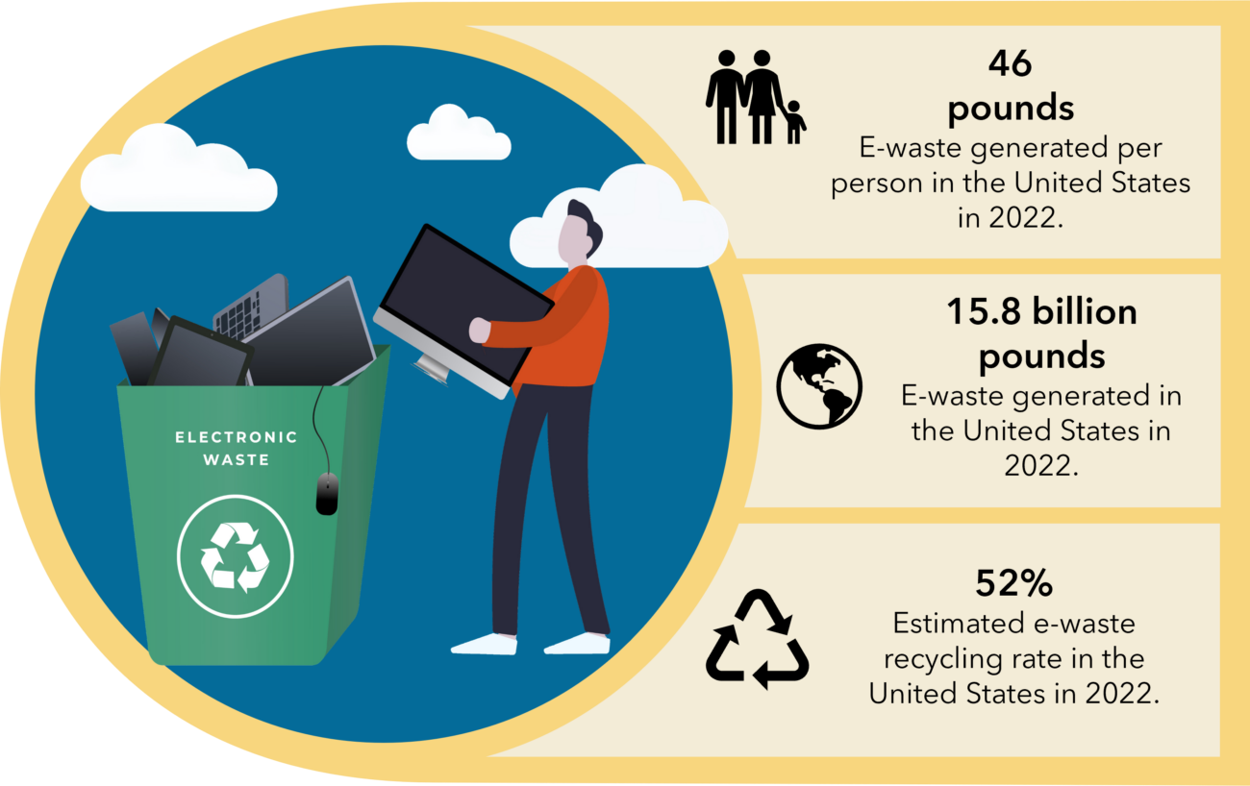
Go Digital with Digifli
Reduce e-waste and printing cost.
Increase awareness and engagement.
Aligns with CA Senate Bill (SB) 1383 to reduce paper consumption and waste.

Slide 4
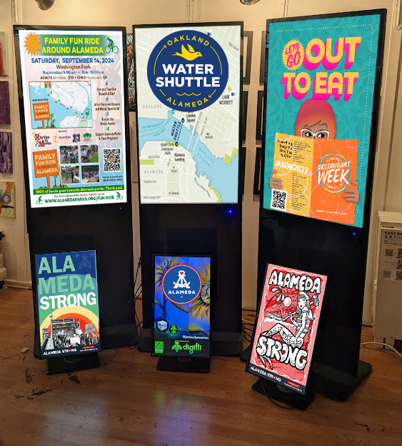
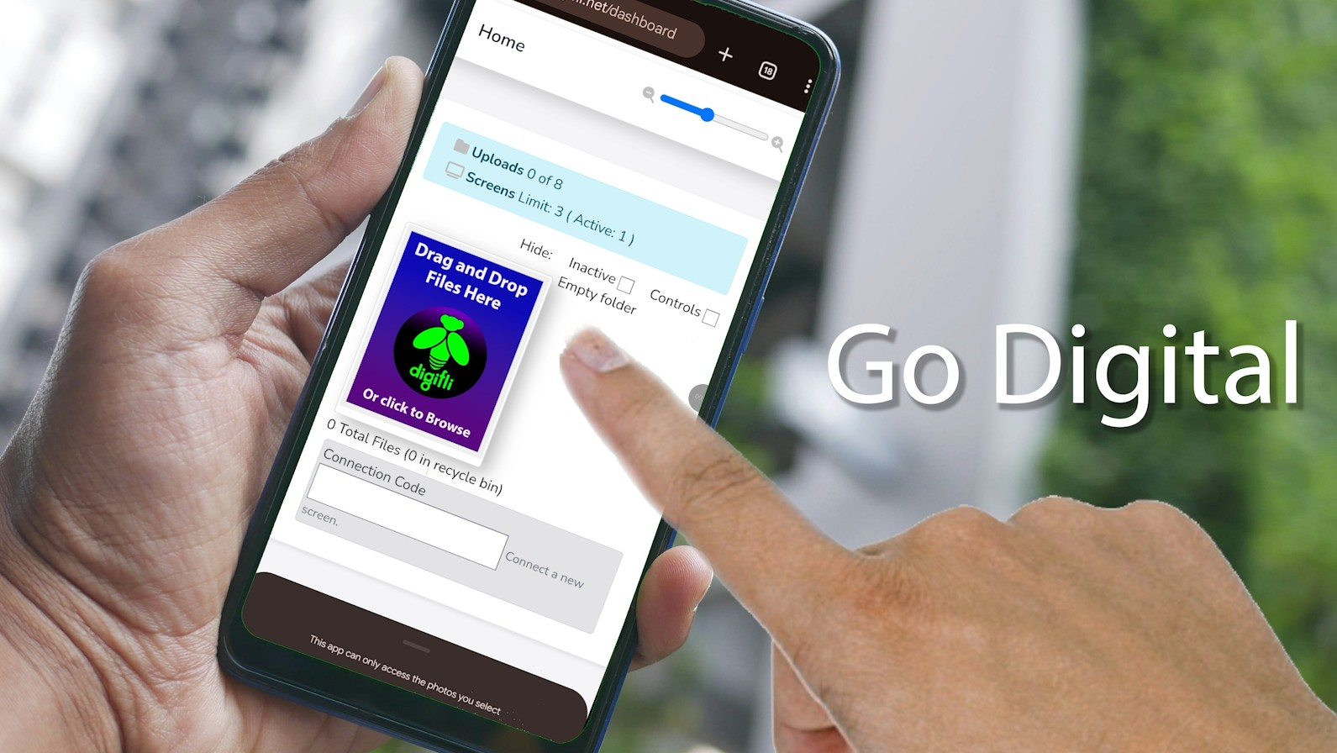
Digifli vs. Traditional Digital Signage
No complex software or apps. As simple as posting a photo on social media. No schedules, timelines, templates, or design software to learn.
Digifli is best for people who:
Manage dozens of existing postings.
Already have the flyers created.
Need a simple fast publishing solution.
Need automatic removal of past events.
Digifli is NOT ideal for people who:
Need templates and design features.
Only have one or two posts at a time.
Need a menu board.
Want to post videos or manage rotation schedules.
If you have 10 flyers on your desk or in your phone, drag them into Digifli and they are instantly in rotation on all your screens.
43” Elite Kiosk and 26” Countertop models

Slide 5
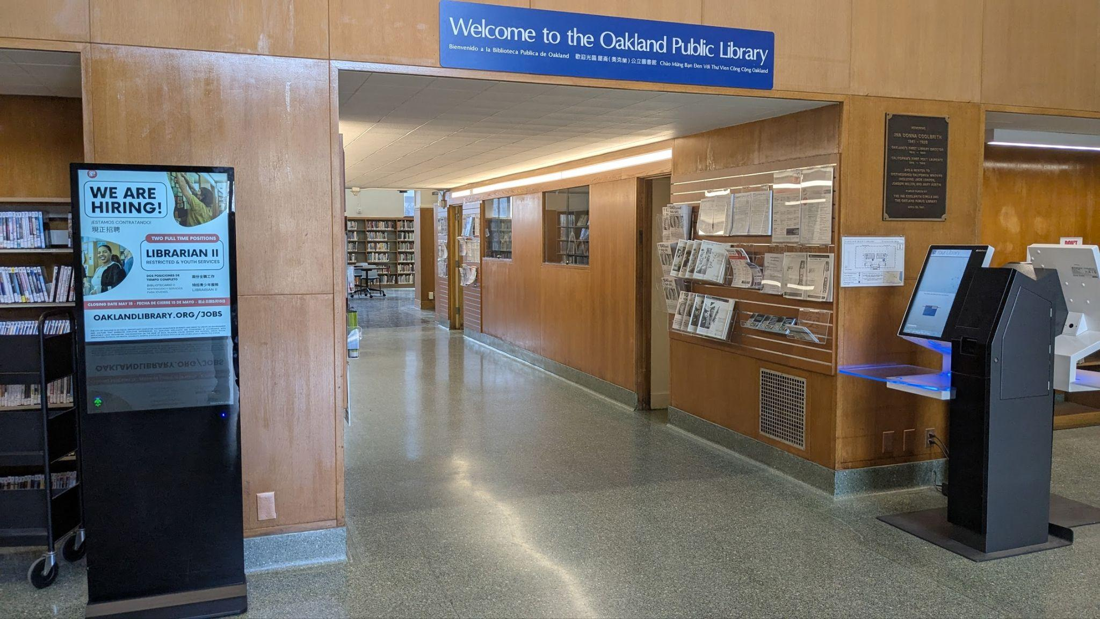
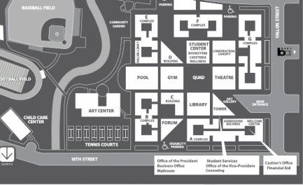
One click pushes
to all your locations.
One click publishing.
A simple intuitive interface.
Add new screens in minutes.
Easily manage dozens of files.
Control from anywhere through our website.

Slide 6
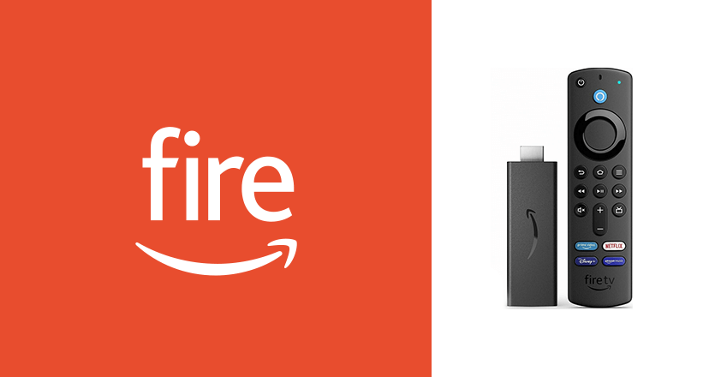
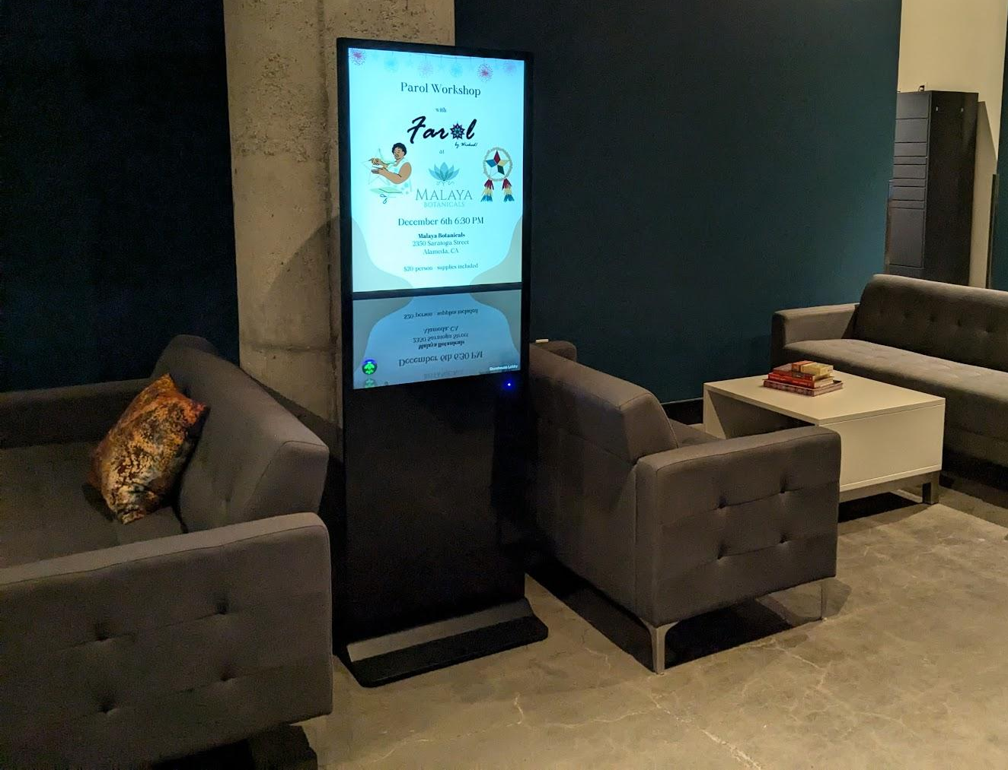
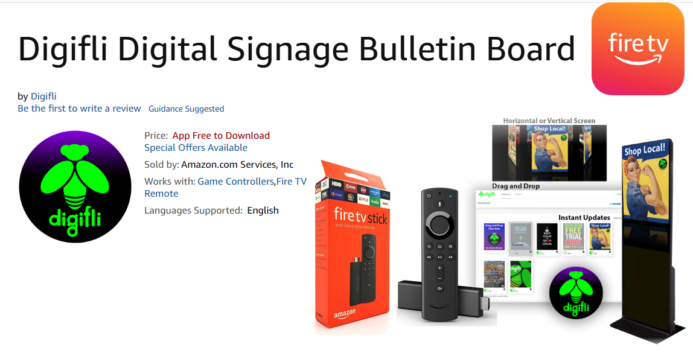
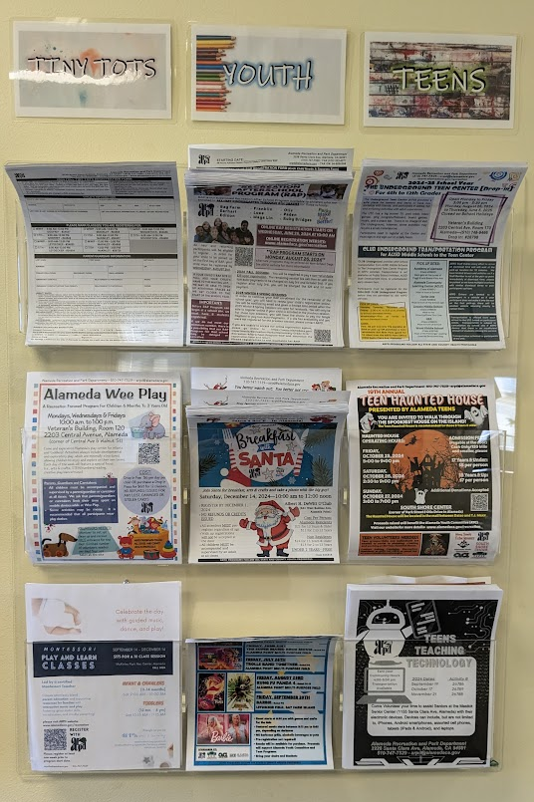
Digifli runs on “off-the-shelf” hardware
No proprietary players to buy. Runs on FireTV sticks and Raspberry Pi. Works with any TV or monitor. Use your existing equipment or we can help you source what you need.
From This To This
Lease a 43” kiosk and account for.
$65/month

Slide 7
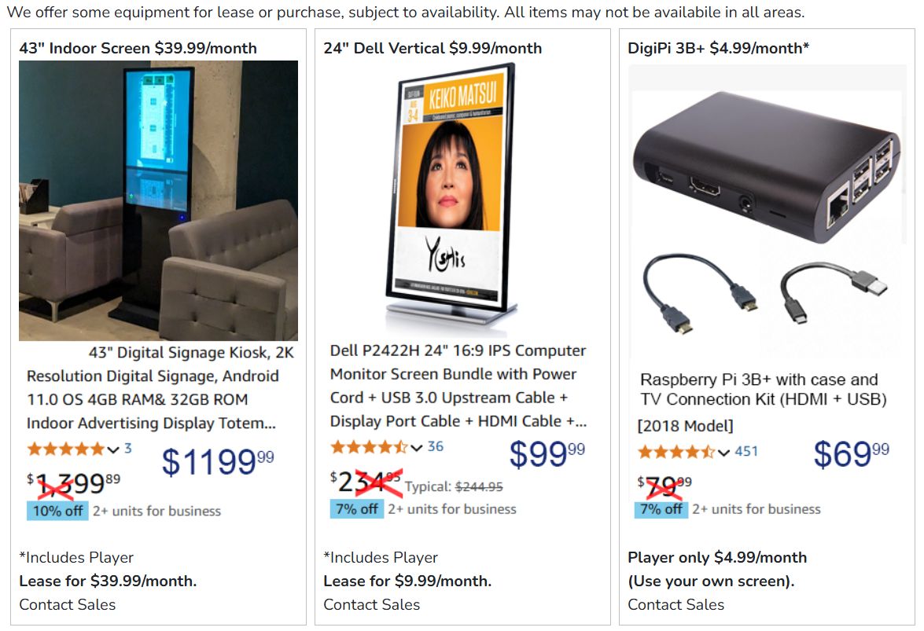
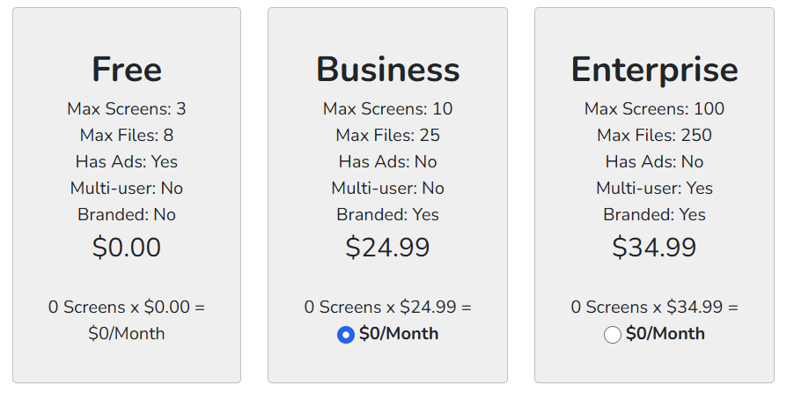
Affordable solutions
Digifli can supply and maintain all the equipment and software with inexpensive leasing and licensing options. We can help you utilize existing equipment or purchase it yourself.
Prices effective 3/25 - Does not include installation fees.

Slide 8
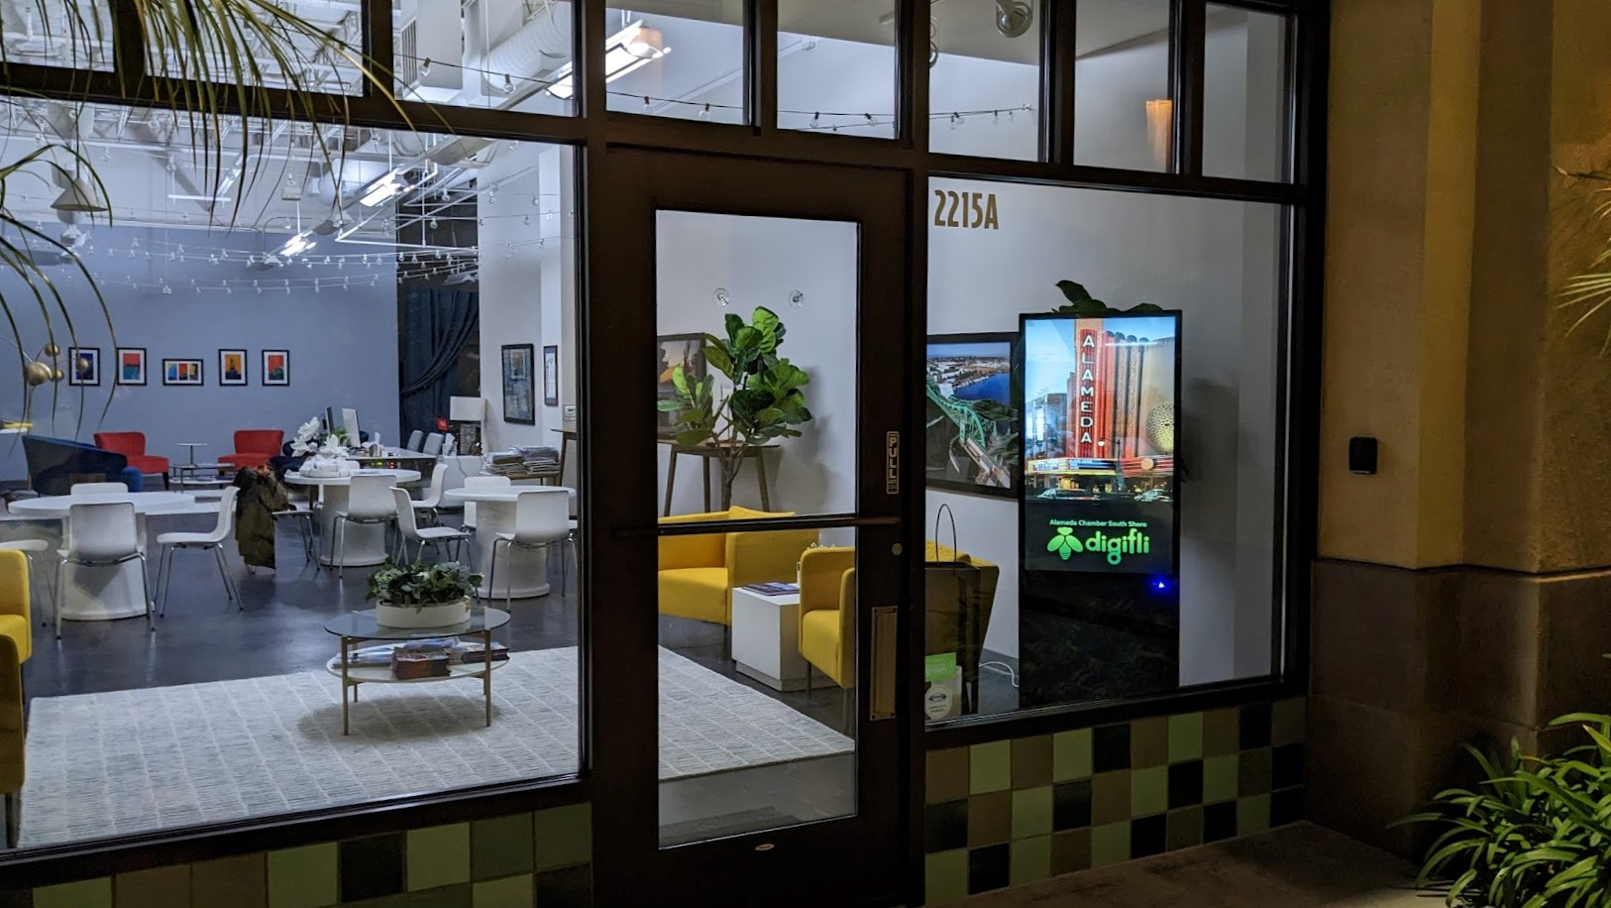
Next steps:
Schedule a live demo or try it yourself.
Contact Wes wes@digifli.com for a quick demo or to get a quote.
Create a free account at Digifli.net and try it out.
Install the FireTV app on your Amazon Firestick and start using Digifli today!
Digifli LLC 1516 Oak St. #203 Alameda, CA 94501

